Slide 1


GEOAXIS
INNOVATION
GEOAXIS
LAND SURVEYING
DIGITAL MAPPING SERVICES
WEB SOLUTIONS
https://geoaxis-surveying.vercel.app/

Slide 2

GEOAXIS
ABOUT
GeoAxis Web Solutions is a modern digital service provider specializing in high-quality, performance-driven websites that highlight your services and featured projects, strategically built to attract, engage, and convert potential clients.
At GeoAxis Web Solutions, we believe that every business deserves a strong digital foundation. That’s why we focus on creating solutions that are fast, mobile-ready, SEO-friendly, and aligned with your brand identity.
02

Slide 3
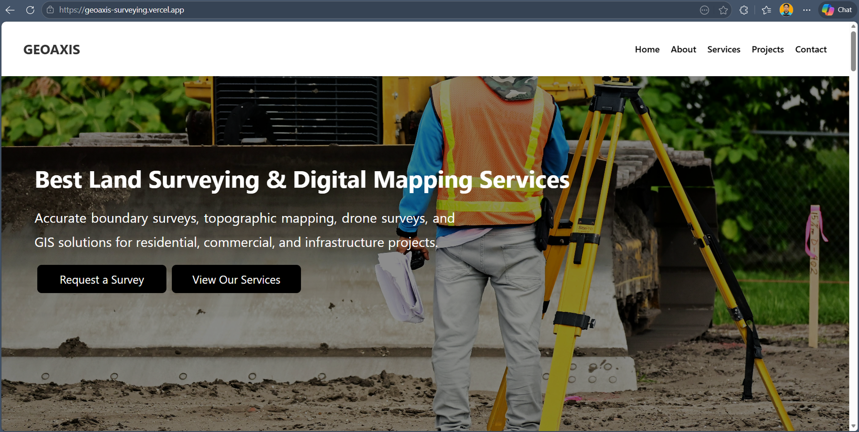


GEOAXIS
WHAT THIS WEBSITE CAN DO FOR YOU
Present your services and feature projects in a clean and credible way
Build trust with potential clients through a modern web application
Make your business easily discoverable online (SEO-ready structure)
Generate inquiries through integrated contact forms
Fully responsive — works perfectly on mobile, tablet, and desktop
03

Slide 4

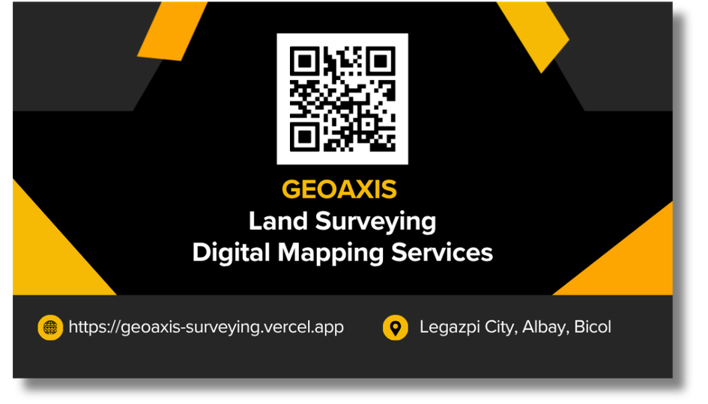
GEOAXIS
SAMPLE BUSINESS CARD

Slide 5




GEOAXIS
PACKAGES
Basic Business Website
Professional Website
Fully Customize Website
P15,000 - P30,000
P30,000 - P80,000
P80,000 - P150,000+
Best for: Startups, Local Businesses, and Service Providers
Best for: Growing businesses that want stronger branding and higher conversion
Best for: Established businesses, agencies, and companies needing automation or systems
05

Slide 6


GET IN TOUCH
We build custom and scalable web applications with modern, user-centered design and interactive experiences that drive business growth and success - Anthony Andes
Mobile Number
Email Address
+63929 500 2123
andesanthony08@gmail.com
Address
Legazpi City, Albay, Bicol, Philippines

